Slide 1

DOCTOR APPOINTMENT BOOKING AND
ONLINE CONSULTATION WEBSITE
NAME: G.E.KARTHICRAJA
REGISTER NO: 2213101033209

Slide 2

About the Website
Our website provides a seamless doctor appointment booking and online consultation platform specializing in acupuncture and hypnotherapy. We focus on natural healing methods to help with stress, anxiety, pain, and other health concerns. Run by a certified expert, we offer both in-clinic and virtual consultations for personalized treatment. Patients can explore secure payment options, easy appointment scheduling, and customized healing plans. With a commitment to safe, drug-free treatments, we help individuals achieve better health naturally. Book your consultation today and start your journey toward holistic healing!

Slide 3
Hardware Requirements
COMPONENTS
REQUIREMENT
Processor
Intel i5
RAM
8 GB
Hard Disk/SSD
250 gb

Slide 4
Software Requirements
SOFTWARE
DETAILS
Operating System
Windows 10, 11
Vscode
Front End
(HTML, CSS)
Google Apps Script
Back End
(JavaScript)

Slide 5
Work Flow
START
DOCTOR
PATIENTS
DOCTOR DASHBOARD
BOOKING PAGE
VIEW UPCOMING
APPOINTMENTS
VIEW AVAILABLE
TIME SLOTS
PAYMENT DETAILS
BOOK APPOINTMENT
END

Slide 6
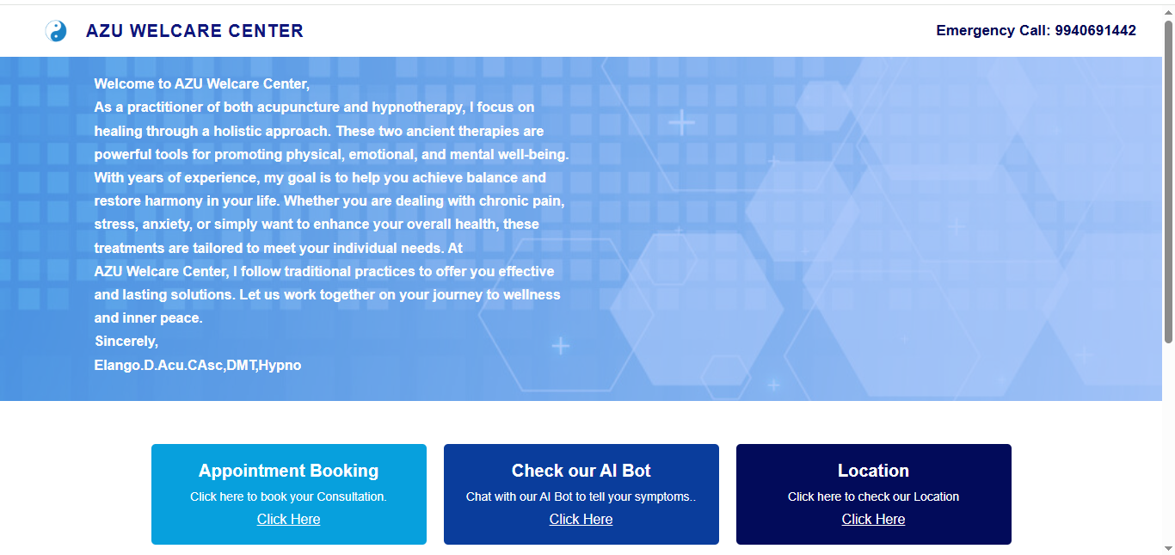
Home Page:

Slide 7

Home Page(2):

Slide 8
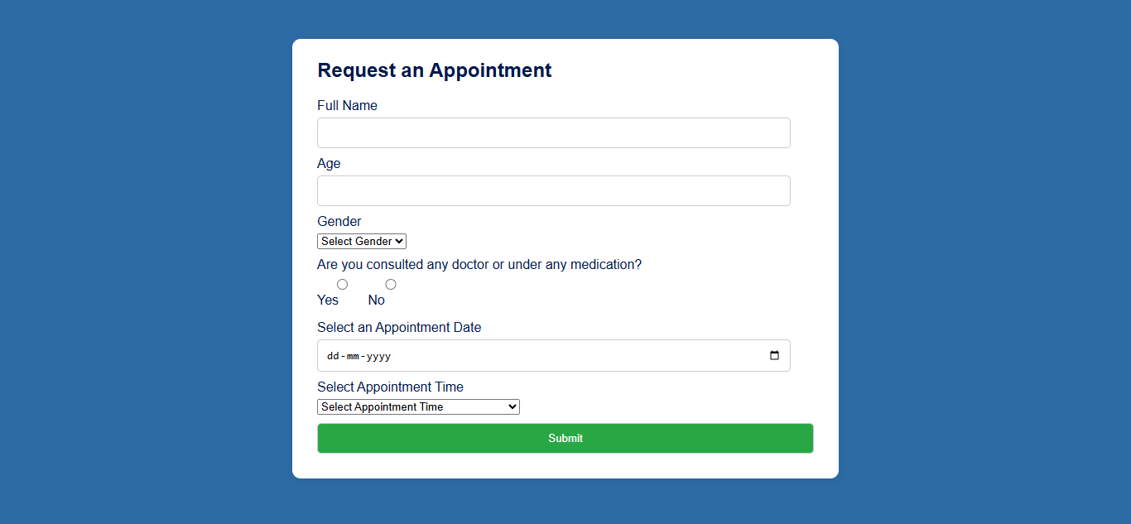
Booking Page:

Slide 9
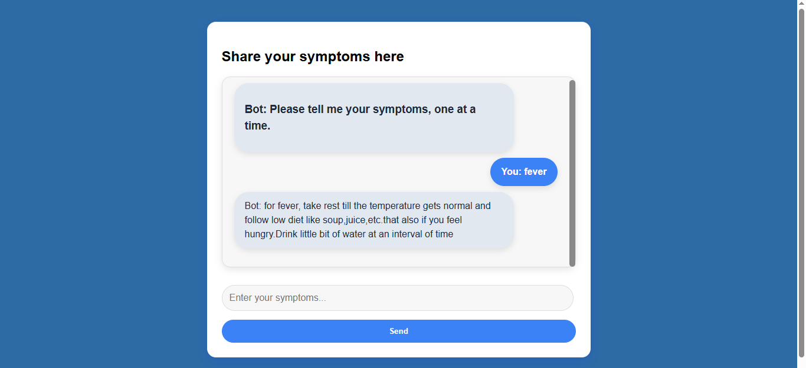
AI Bot Page:

Slide 10
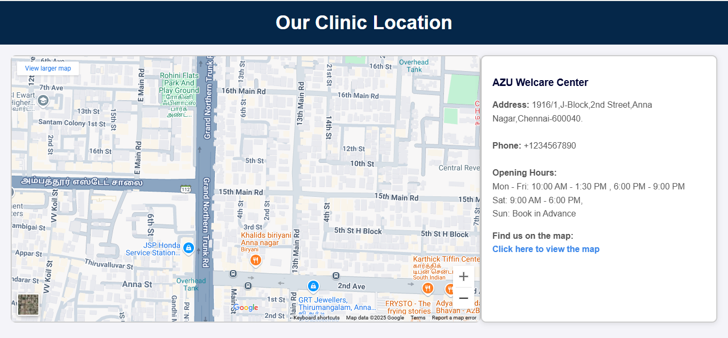
Location Page:

Slide 11
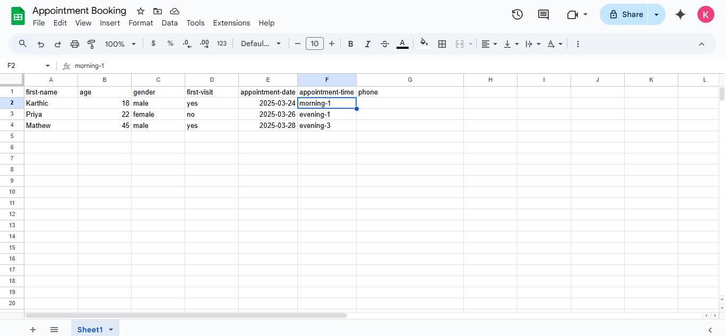
Google Sheet:

Slide 12
Thank You

